Slide 1
Super Forecasters
CRIME analysis of Mexico
Faraz Ahmed, Pedro Armengol

Slide 2
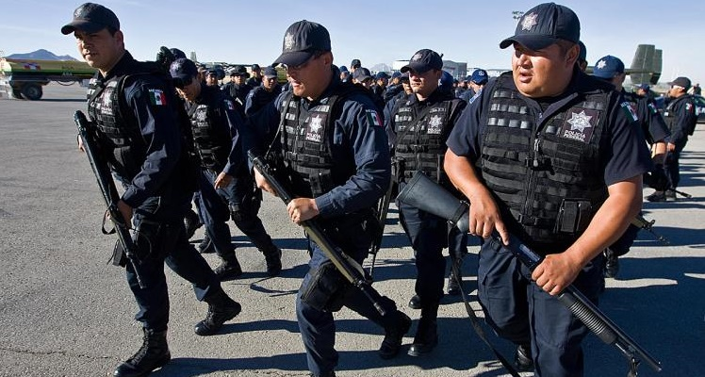

Slide 3
Agenda
Goals
Process System
Data Collection and Data Cleaning (Backend)
Predictive Analytics
Front End (Website, HTML, Visualization)

Slide 4
Project’s Goals
Technical
Statistics analysis of the crime rates of Mexico (state-wise, year-wise etc.)
Learn to apply the Lasso Technique (predictive analytics)
Create a website and connect it with backend data for a broad audience
Theoretical
What factors influence the crime rate the most?
Can we predict ahead of time the crime rate for each state given a year?

Slide 5
The Process System
Data Collection and Cleaning
Descriptive Analytics (Front End)
Results
Predictive Analytics

Slide 6
Data Collection, Data Cleaning and SQL
Data Collection
Data Cleaning
25 CSVs files from the Ministry of Statistics in Mexico (Covariates)
Crime data obtained from crime prosecution statistics (1 CSV)
Drop missing values and duplicated columns, generate lags and changes, normalize information (for predictive analytics).
SQL
DB Schema, layout of relational database and connection SQL - Python
Different formats ROWS -> COLUMNS (function)

Slide 7
Predictive Analytics
Lasso Technique : adds a factor of sum of absolute values of coefficients in the optimization objective
SQL
State-Year predictions
In sample exercise : predictions for 2008-2011 / using information 2005-201o
Dataframe: Actual Observation -> LAGS (Levels and Changes)
Lasso Class: Dependent (1 column df) | Independent (n column df)
Methods:
Select model: select alpha (penalization of coefficients magnitude) based on minimization of Mean Residual Sum of Squares
Lasso Coefficients
Correlation: efficiency metric
Notes:
Trade-off between MRSS (Mean Residual Sum of Square – Value of Coefficients

Slide 8
Front End
Used Flask, Jinja Templates (with html and CSS)
Different options for Descriptive and Predictive Analysis
Charts (js), Pearson correlation matrix, tables

Slide 9
Main Results
Baja California, Tamaulipas, Guerrero among other have a high persistence of crime over time.
The main factors of prediction change for each type of crime: each crime has a different set of determinants.
Common thief is the most common non-violent crime, while homicide is the most common violent crime.

Slide 10
Limitations and Future Scope
Technical: -Integration of web pages (less steps)
Results of Predictive Analytics (Robustness analysis)
Future Scope:
-Combine Lasso with other techniques for a comparison matrix
-Same Analysis for smaller time and geographical units.

Slide 11
Takeaways
Able to collect and clean vast amounts of data
Technical: flask/html, lasso technique, javascript, python visualization
Theoretical: analyses of the crime in Mexico

